Slide 1


PackIt: A Virtual Environment for Geometric Planning
Ankit Goyal Jia Deng
Department of Computer Science
Princeton University
Notes:
Hello Everyone. I am Ankit Goyal, a PhD student at Princeton University. Today I will be talking about our work “PackIt: A Virtual Environment for Geometric Planning”. This is a joint work with my advisor Prof. Jia Deng.

Slide 2
Motivation
Notes:
Let’s start with the Motivation for our project.

Slide 3
Geometric Planning
Simultaneously reasoning about geometry and planning action crucial for humans
Comes in handy while grocery shopping, rearranging room, warehouse management
Symbolic Planning — Manipulating Symbols
Geometric Planning — Manipulating Geometries
Notes:
Simultaneously reasoning about geometry and planning actions is a crucial ability that humans have.
This ability comes in handy in many scenerios like grocery shopping, rearranging room or wharehouse mangement. In all these cases, we think about the the geometry of the object while planning actions. We refer to this ability as the geometric planning ability.
Just as symbolic planning requires manipulating symbols,
geometric planning requires manipulating geometries or shapes. In order for agents like robots to operate in the real world, they need to have the geometric planning ability.

Slide 4
Benchmark for Geometric Planning
Benchmarks needed to develop and evaluate systems
Existing benchmarks ill-suited for geometric planning
Interactive Environments — focus on high level task planning, sufficient to treat objects as boxes
Robotic Environments — focus on low-level control, no reasoning about geometry of multiple objects
Notes:
Benchmarks needed to develop and evaluate systems. We have benchmark to test agents in various abilities like navigation, object manipulation.
However, existing benhmarks are slightly ill-suited for geometric planning.
In Interactive Environments the focus on high level task planning, sufficient to treat objects as boxes.
In Robotic Environments, the focus is on low-level control, no reasoning about geometry of multiple objects

Slide 5
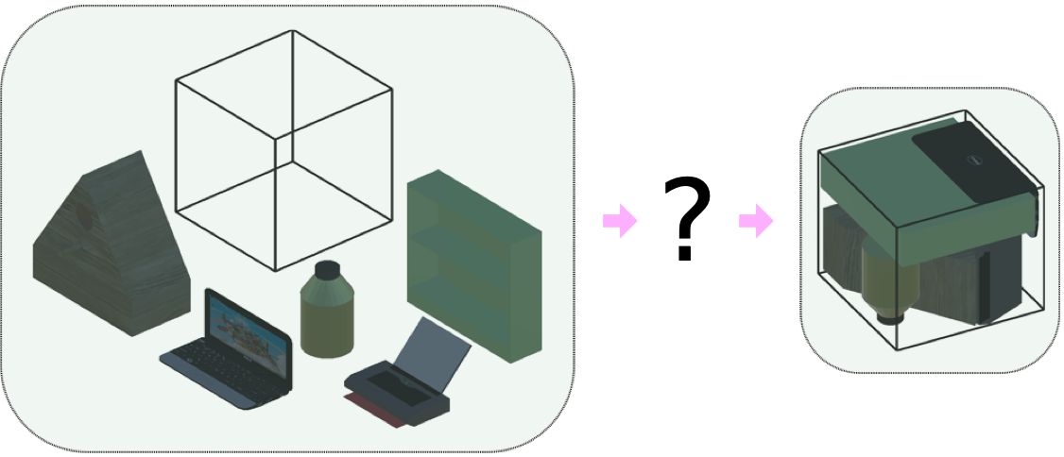
PackIt
Objective
Packing serves as proxy for geometric planning
Packing in many domains like 3D printing
Input
Notes:
We fill this gap by presenting PackIt, a benchmark for geometric planning.
Packit poses a packing task where an agent is provided with shapes and box.
The agent needs to come up with a plan like how to rotate each shape, where to place them etc.
so as to put all the shapes inside the box.
Here, the packing serves as proxy for geometric planning. It requires simultaneously reasoning about the geometry of different shapes for planning actions.
Packing in virtual environment like 3D printing where the objective is to put the shapes in a way so as to minimize the wastage of material.

Slide 6
PackIt
Two components:
Dataset of Packs
Virtual Environment
Notes:
There are two components to PackIt,
first is the dataset of Packs and
second in the virtual environment. I will explain both the components one by one.

Slide 7
PackIt
Two components:
Dataset of Packs
Virtual Environment
Notes:
Lets start with the Dataset of Packs.

Slide 8
Dataset of Packs
Deconstruct
a Pack
Pack
Packing Task
Ensures each task has a solution
Hypothesis: denser packs lead to harder packing tasks
Genetic algorithm is used to create dense packs
Notes:
We refer to a pack as an arrangement of some shapes inside a box. We need such a dataset of packs so that
We can deconstruct a pack, i.e. move the shapes outside the box and rotate them
To generate the a packing task.
This process ensures that each task has atleast one solution exists for the packing task.
Moreover, we want harder tasks, so that they cannot be solved trivially and require an agent to reason geometrically. Our hypothesis is that denser a pack it is, harder it is solve it. This hypothesis is verified empirically later on.
Hence, we use a genetic algorithm to create a dataset of dense packs.

Slide 9
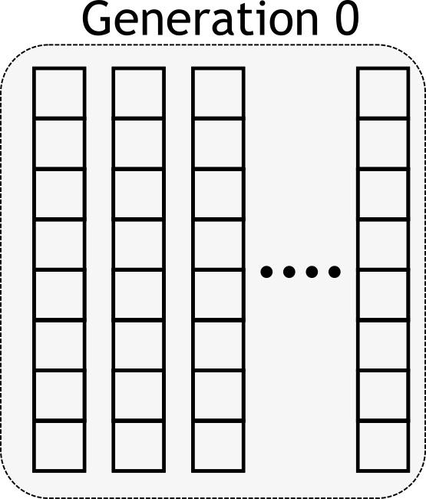
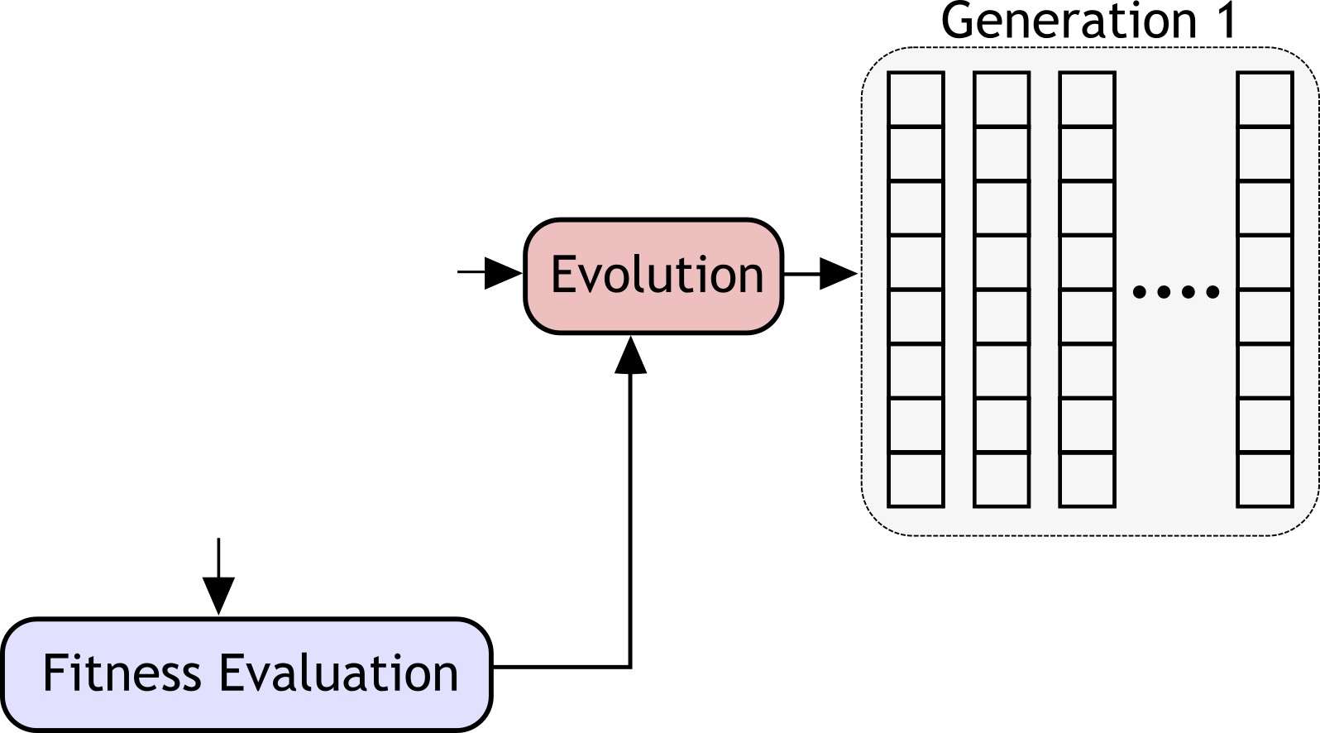
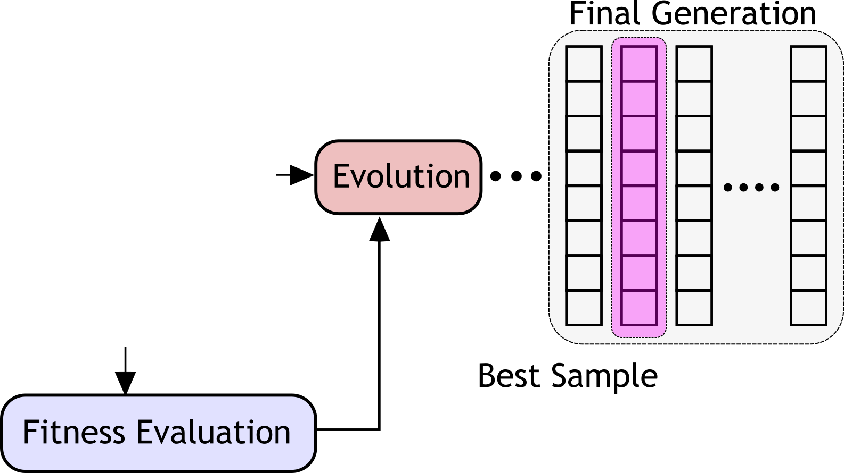
Genetic Algorithm
Notes:
Lets look at a very brief overview of the genetic algorithm.
Each array represents a chromosome (or code), or a sample in the population. Each chromosome has fitness score. The objective is to find a chromosome with a high fitness score.
This is done through evolution. In evolution we create off-spring by crossover and mutation. Only the fittest offspring pass on to the next generation. The population size remains the same.
This process is repeated multiple time till we reach some terminal condition from which the best sample based on its fitness score is selected.

Slide 10
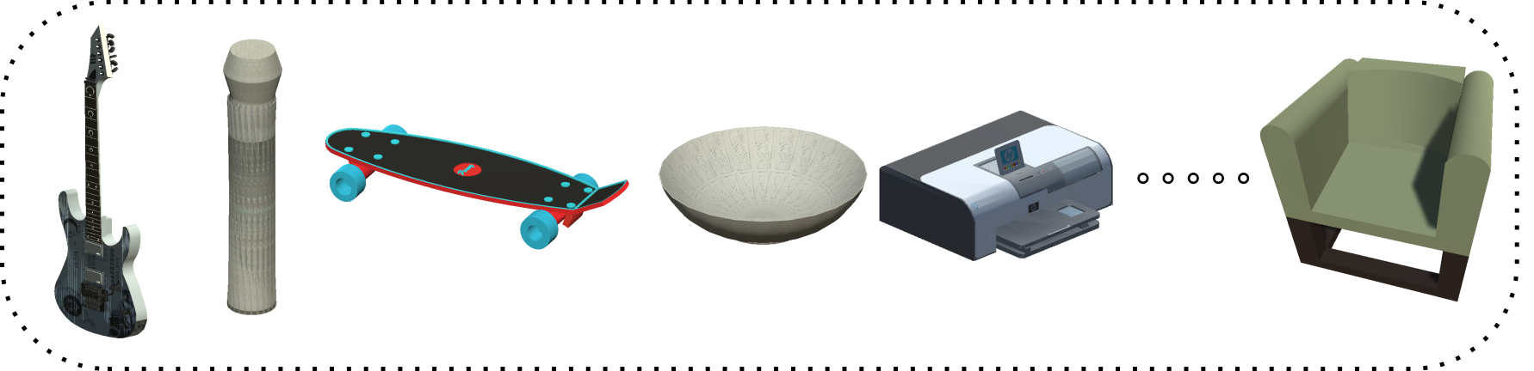
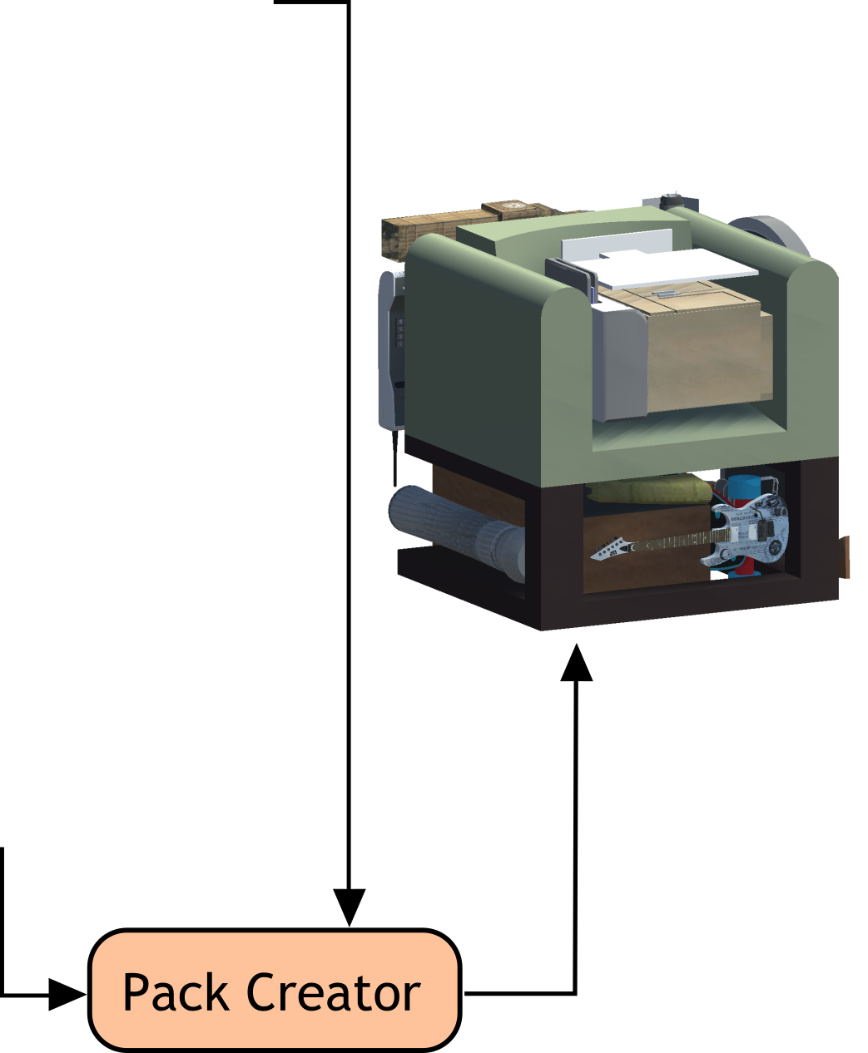
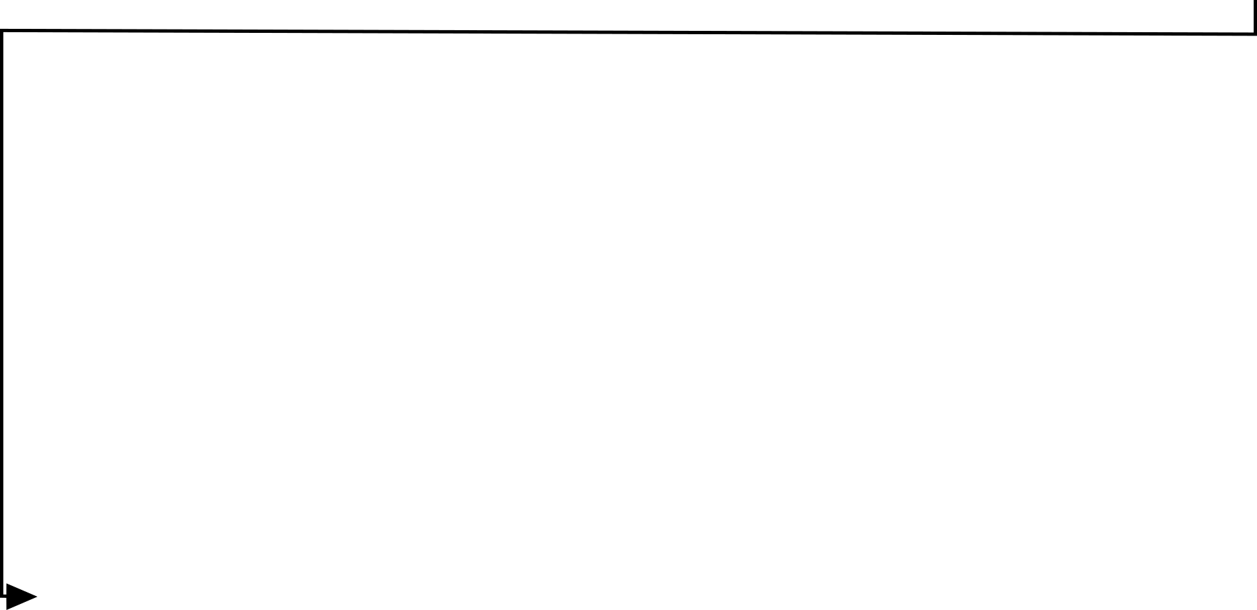


Genetic Algorithm
Notes:
Now we look at what happens in our case. We start with some fixed set of shapes. We are allowed to rotate them, move them or scale them in order to create a pack. We need not even use all the shapes our pack. The objective here is that the final pack should be dense.
Here, each array or chromosome represents a potential pack that can be created from the given set of shapes.
We evolve these chromosomes representing a pack. The fitness here is how dense is the pack.
Finally we select the best Pack.

Slide 11
Pack Creator
Chromosome encodes order of selecting shapes, their rotation and scale
Shape selected in this order
It is then scaled and rotated
If it can fit in the box, it is placed at “lowest” location. Else left outside.
Notes:
One thing I didn’t discuss was what exactly is this chromosome which represents a pack. Specifically, a chromosome encodes order of selecting shapes, their rotation and scale. To generate a pack from the chromosome and the shape,
We select shape by the order specified in the cromosome.
Then we scale and rotate that shape
If it can fit in the box, it is placed at “lowest” location. Else left outside.

Slide 12
Dataset Details
Shapes: ShapeNet [1], mutually exclusive in Test/Train/Val
Evolution for one pack takes 10 hours on 2 CPUs
991 train, 515 Test, 503 Val
[1] Chang, Angel X., et al. "Shapenet: An information-rich 3d model repository." arXiv:1512.03012 (2015).
Notes:
We use subset of shapes from shapenet. The shapes used in the packs for test/train/validation are mutually exclusive.
Evolution is an expensive process, it takes takes 10 hours on 2 CPUs
Finally, we end up with about 1k packs in train, and about 500 packs in test and validation set

Slide 13
PackIt
Two components:
Dataset of Packs
Virtual Environment
Notes:
So now we end with dataset of packs, each of which gives us a packing task. Now lets look into the second component which is the virtual environment.

Slide 14
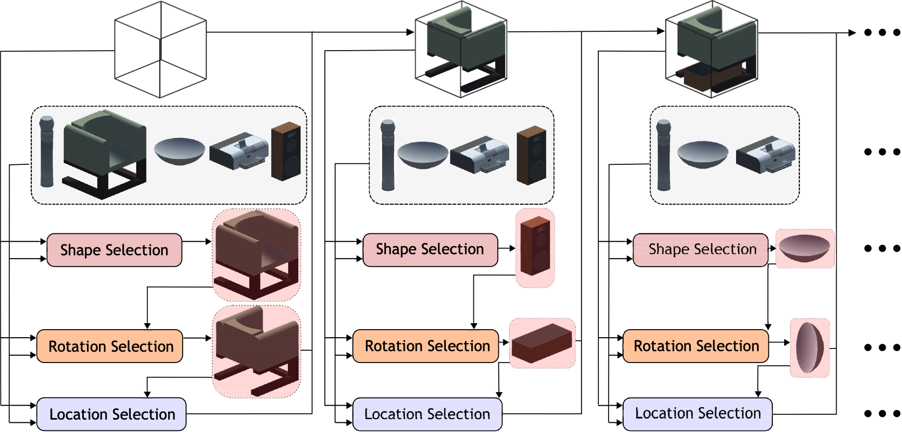
PackIt Virtual Environment
Notes:
Recall that in PackIt an agent is proved with shape and box and it need to put the shapes in the pack.
This packing process is divided into three steps.

Slide 15
PackIt Virtual Environment
Notes:
The first step is shape selection

Slide 16
PackIt Virtual Environment
Notes:
The second step is rotating the selected shape

Slide 17
PackIt Virtual Environment
Notes:
Finally, the rotated object is placed inside the box

Slide 18
PackIt Virtual Environment
Notes:
This sequence is repeated multiple times unless the a terminal condition is met that is the current shape cannot be put in the box or all shapes are in the box.

Slide 19
PackIt Virtual Environment
Notes:
There is another variant called PackIt Easy.. please refer to the paper

Slide 20
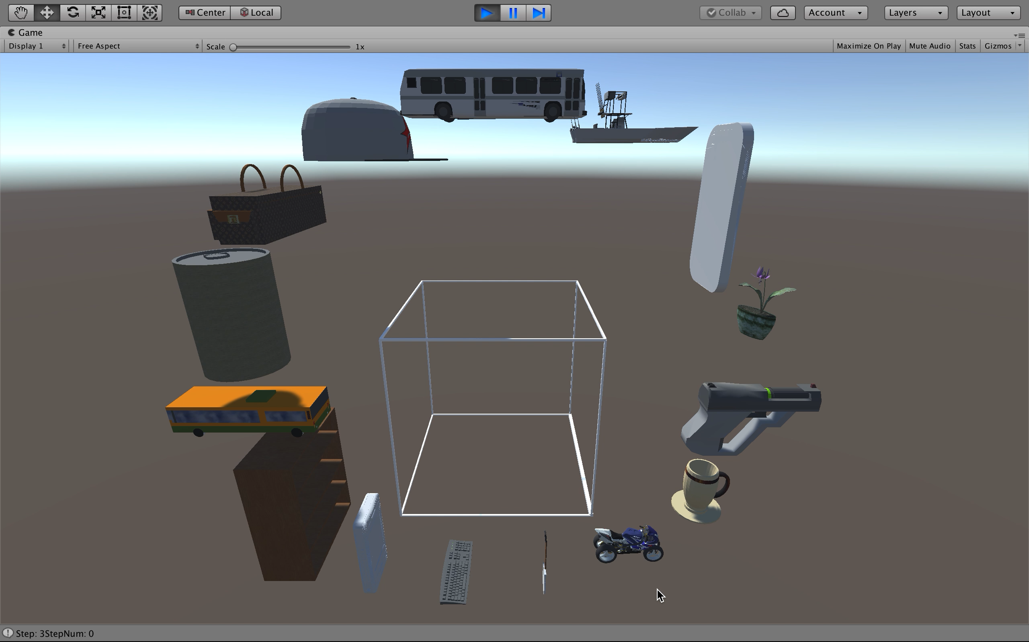
Notes:
This is a small video showing the groundtruth rotation and location for each shape

Slide 21
PackIt Virtual Environment
Metrics:
Avg. Reward: (vol. of object in box) / (vol. of all object)
Success@x: % of samples where reward > x

Slide 22
Baselines
Notes:
Apart from the environment, we also propose some baselines.

Slide 23
Baselines: Heuristic Based
Shape Selection: Largest First
Location Selection: Bottom-Left-Back Fill
Rotation Selection: Aligned Shapes
Notes:
For shape selection we use the largest first. This is alos used in prior work.

Slide 24
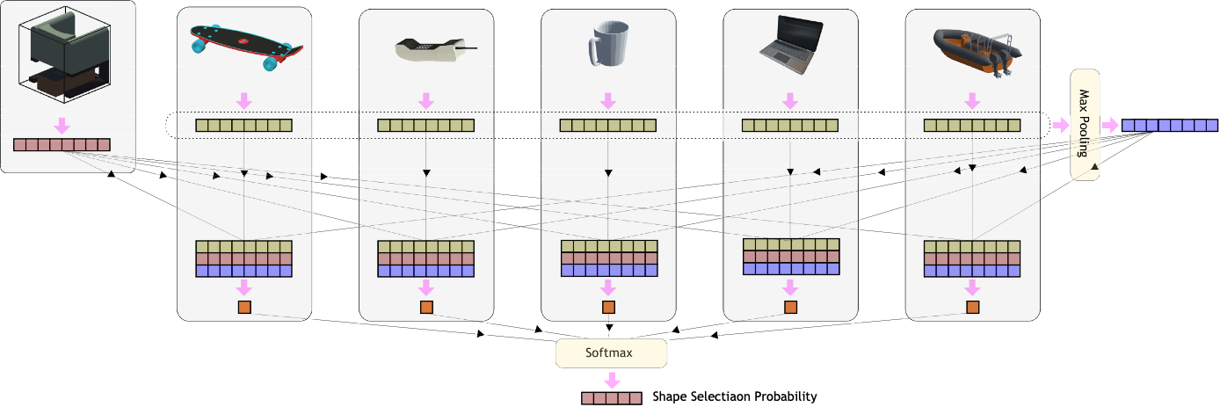
Baselines: Learning Based
Learning Shape Selection
PackNN:
Extract voxel features for each shape and box
shape + box + max-pooled features to predict next shape
Trained using policy gradients, PPO [1]
[1] Schulman, John, et al. "Proximal policy optimization algorithms." arXiv preprint arXiv:1707.06347 (2017).
Notes:
We also propose a learning based method for PackIt.
Specifically, we use learning to for shape Selection
We propose a neural network architecture called PackNN for this.
Given some configuration of shapes in the box, and set of shapes to choose from, PackNN first extracts voxel features from each shape and the box.
The voxel features for each shape is concatenated with the box feature and global max pooled feature, and passed through a perceptron to generate a score for each shape. This score represents the extent to which one should select that particular shape.
We train the shape selectetion policy isng policy gradients, specifically we use PPO i.e. proximal policy optmization.

Slide 25
Experiments

Slide 26
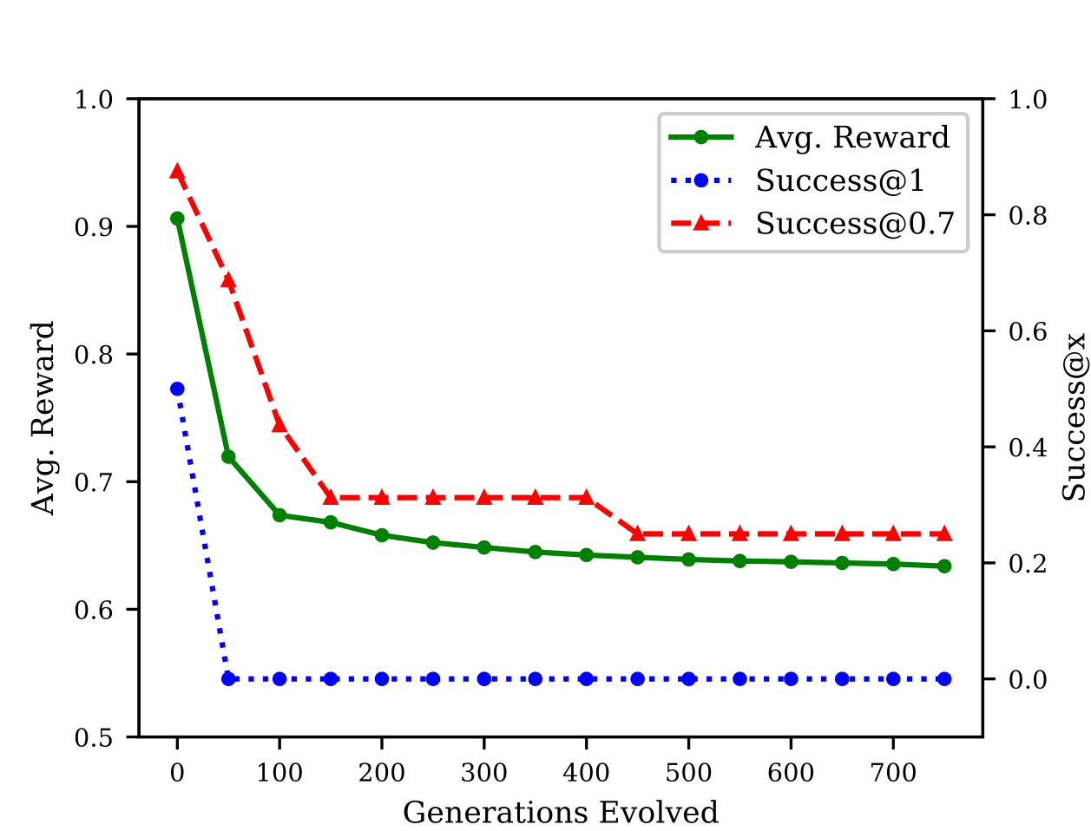
Evolution leads to harder Packs
Notes:
We first verify our hypothesis that denser packs lead to harder tasks. As we can see, with more evolution the performance of the heuristic baseline decreases.

Slide 27
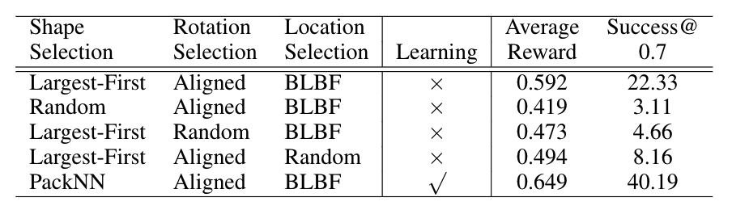
Performance of Baselines

Slide 28
Performance of Baselines

Slide 29
Performance of Baselines
Notes:
More experiments with back-tracking and beam search can be found in the paper.

Slide 30
Conclusion
PackIt, a virtual environment for geometric planning
Generate packs using evolution
Virtual environment where packing task broken into steps
Evaluate heuristic as well as learning based baselines
Notes:
In conclusion, we present packit a . For PackIt, we generate a dataset of packs using evolution. We create a virtual environment where the packing task is broken into steps.

Slide 31
Thanks

